Slide 1


Unit 6.5 (Extra) MQTT Advanced

Slide 2
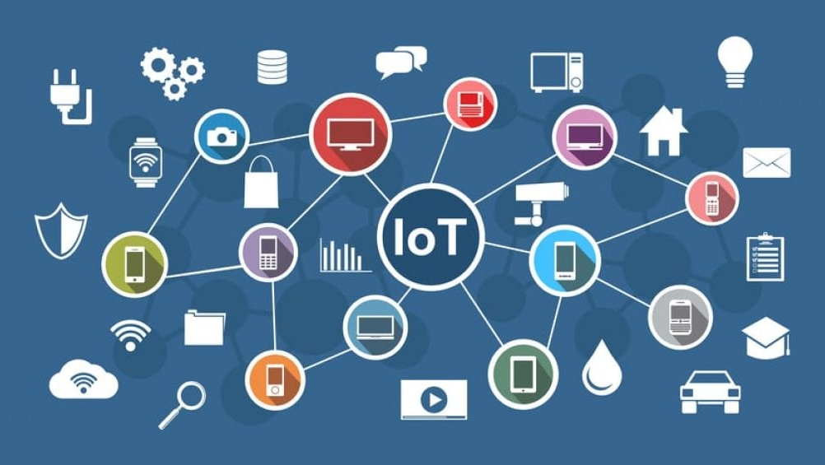
IoT Connectivity

Slide 3
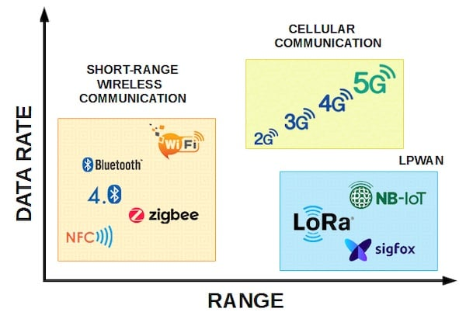
IoT Connectivity
Speed or Data Rate: the amount of information to be transmitted within a time duration.
Range: the maximum distance between two intercommunicating nodes. It mainly depends upon the transmitting power, the frequency band used, and the type of modulation. It can be also affected by the meteorological conditions or the physical placement of the nodes.
Interoperability: the capability to exchange information between nodes, even if they are of different types.
Cost: the price of installing and maintaining a specific technology. Power consumption, maintenance, and scalability have a big impact on the network cost.

Slide 4
IoT Connectivity
Power Consumption: the amount of energy that a node needs to work within its lifetime. This parameter defines the need for permanent power or the use of a battery.
Scalability: the challenge of deploying a higher number of nodes, increasing the number of end-users, as well as the amount of data to store and process without the need of migrating the technology.
Network Topology: the way nodes communicate with each other. Topologies can be the same as those used in traditional networks. Star, mesh, point-to-point, and point-to-multipoint.
Security: the way to protect data being sent and received.

Slide 5
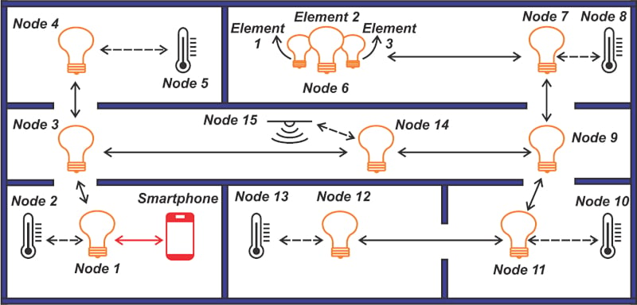
IoT Connectivity

Slide 6
MQTT Foundations

Slide 7

MQTT
MQTT (Message Queuing Telemetry Transport) is a lightweight messaging protocol designed for high-latency, low-bandwidth, and unreliable networks.
It consumes very little power on the device it’s running on.

Slide 8
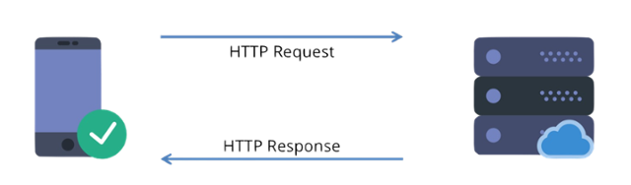
Request-Response
Two actors: Client and Server.
The server is all the time listening to requests that may arrive from its clients
Server only establishes a temporary connection.

Slide 9
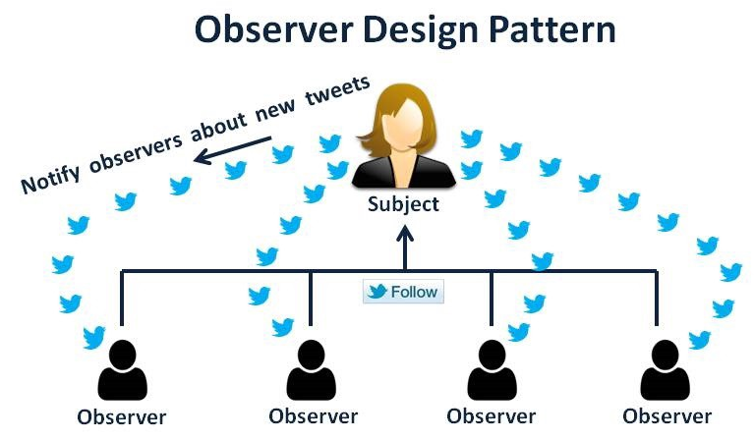
Observer
Observer we have two main actors: the observers and the subject.
Observers will make a request to subscribe to the subject and thus be notified when there is any state change.
Subject will have a list of its observers so that it knows to whom to send notifications when there is a change of state.
The registration can be undone.

Slide 10
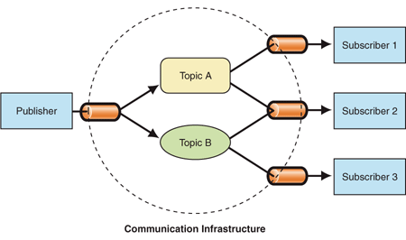
Publish-Subscribe
Like the Observer pattern.
There is a Broker role, which is responsible for filtering messages and knowing exactly who to send them to.
The publisher and subscriber do not need to know each other directly and only need to know the Broker.

Slide 11
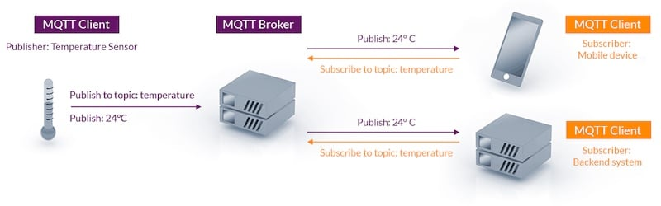
MQTT - Publish-Subscribe Pattern

Slide 12
MQTT Messages
Connect: Attempts to create a connection with the Broker and waits until the connection is established, starting to listen for published messages.
Disconnect: It waits until the client finishes some action that has been performed and ends the TCP/IP connection, thus stopping listening to the messages that will be published.
Publish: returns the information that was sent by the MQTT client.

Slide 13
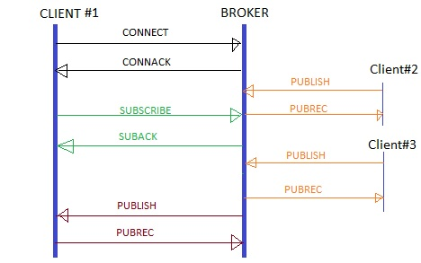
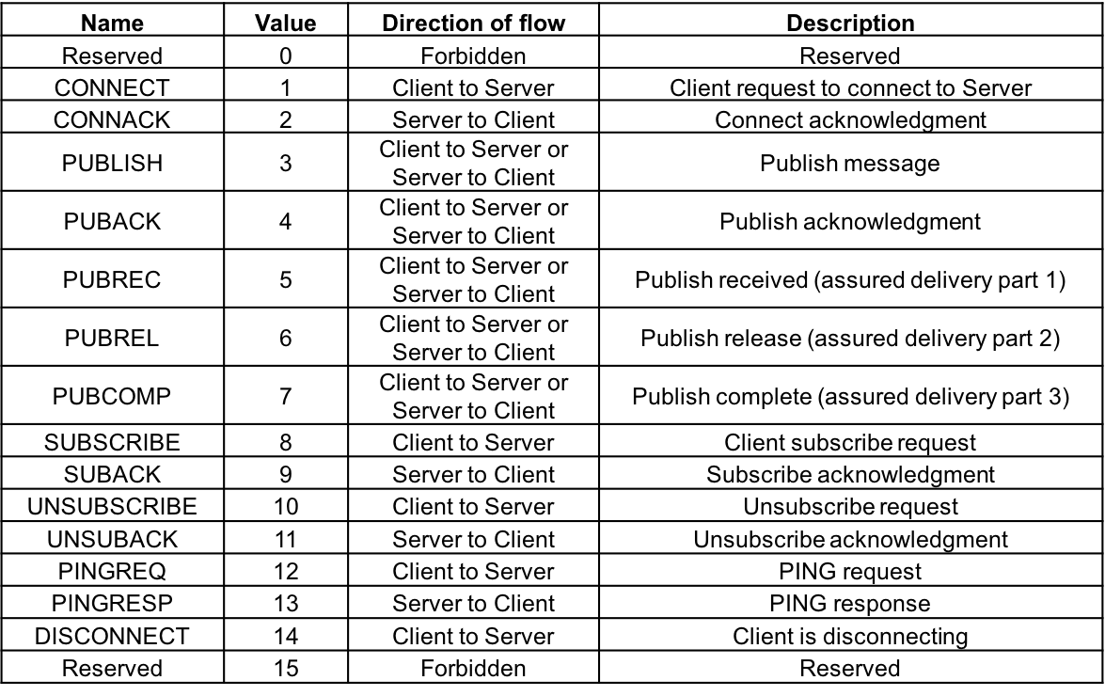
MQTT Basic Flow

Slide 14

Quality of Service
A Quality of Service (QoS) level is simply an agreement between the sender and receiver of a message that guarantees the deliverability of said message.

Slide 15
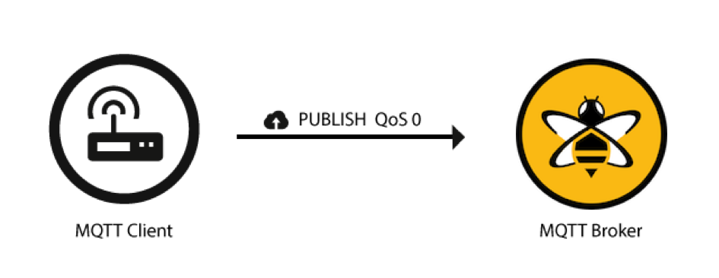
QoS 0: (fire and forget), in this QoS the message is sent only once and there will be no further steps, so the message will not be stored, nor will there be feedback to know if it reached the recipient.

Slide 16
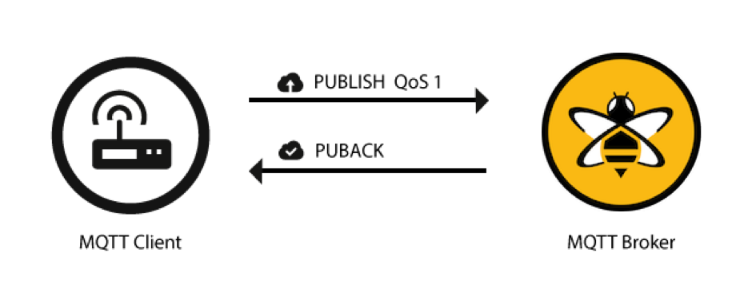
QoS 1: the message is delivered at least once, with a wait for receiving feedback on the delivery of the message, called PUBACK. Not receiving the PUBACK, the message will continue to be sent until there is feedback. In this QoS, it can happen that the message is sent several times and processed several times.

Slide 17
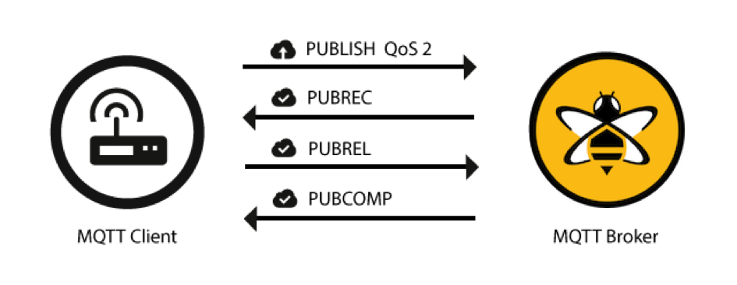
QoS 2: In this transfer mode, the message is delivered exactly once, requiring the message to be stored locally at the sender and receiver until it is processed.

Slide 18
MQTT Advanced Concepts

Slide 19
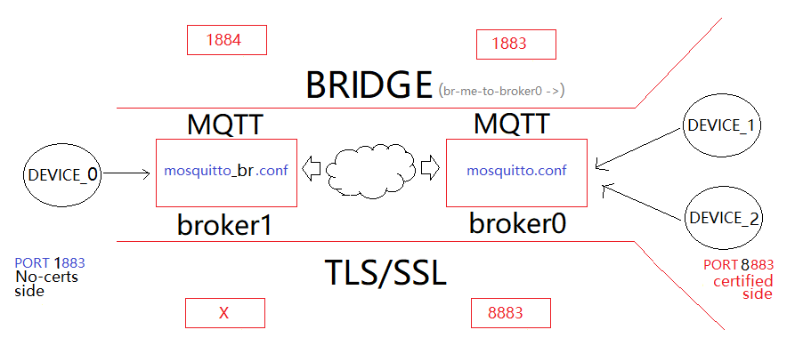
Bridge Mode
There are situations where the publishers and subscribers are not directly connected in the same Broker.
It happens because of scalability, interoperability, or security reasons.
In this situation, we use a Bridge-Broker.

Slide 20
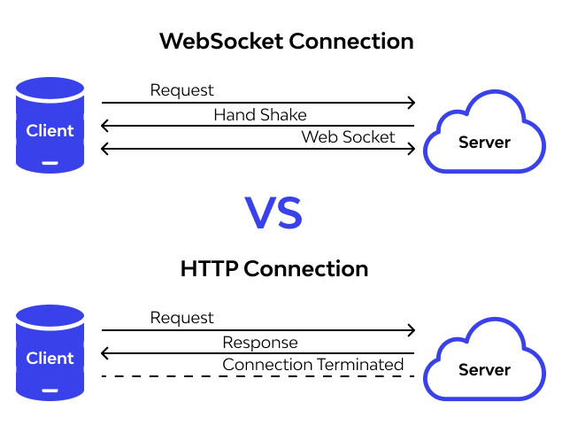
WebSocket
WebSocket Protocol (RFC 6455): was created to allow web applications to conduct two-way communications with web servers, as HTTP cannot do that without awkward workarounds.
A web browser that has WebSocket support allows web applications to communicate with a server like TCP does for regular applications - sending and receiving data asynchronously in both directions.

Slide 21
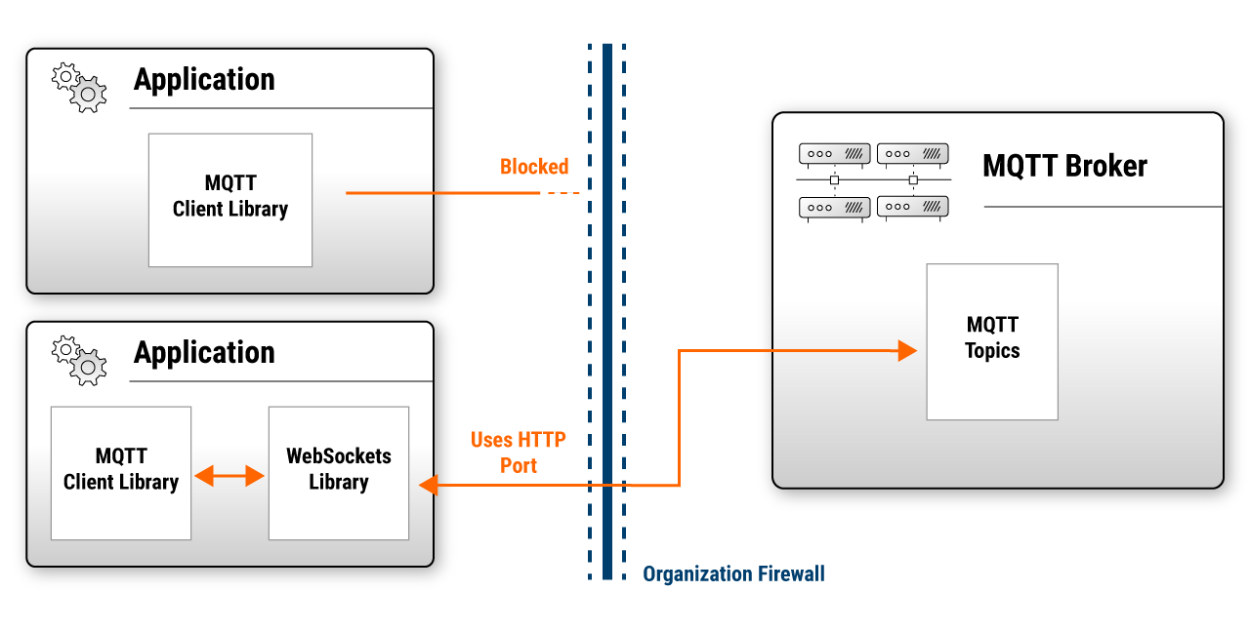
WebSocket
WebSocket is an alternative when the client does not support sending the messages using a direct TCP stack (for example, Java Script).
This approach includes overhead in the communication process.

Slide 22
Security Challenges in IoT
Security is seen as a trade-off between the level of protection and the degree of usability.
IoT devices have limited computing power and memory capacity. Many cryptographic algorithms require more resources than tiny IoT devices possess.
Another security challenge arises from the need to update devices in the field. Critical security issues that require updates to be rolled out to all devices simultaneously are hampered by unreliable networks on which many IoT devices run.
Because user acceptance depends more than ever on easy installation and maintenance, security must be intuitive for the user.

Slide 23
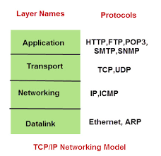
Approaches to security in MQTT
Network level: One way to provide a secure and trustworthy connection is to use a physically secure network or VPN for all communication between clients and brokers.
Transport level: When confidentiality is the primary goal, TLS/SSL is commonly used for transport encryption. This method is a secure and proven way to make sure that data can’t be read during transmission and provides client-certificate authentication to verify the identity of both sides.
Application Level: On the transport level, communication is encrypted, and identities are authenticated. The MQTT protocol provides a client identifier and username/password credentials to authenticate devices on the application level.
Security in MQTT is divided into multiple layers.

Slide 24
Basic Scenario Implementation

Slide 25


Case 1
Humidity: 10%
Topic: Humidity
Humidity: 10%
Subscriber 2
Topic: Humidity
Publisher
Broker
Temperature: 24ºC
Topic: Temperature
Temperature: 24ºC
Subscriber 2
Topic: Temperature

Slide 26
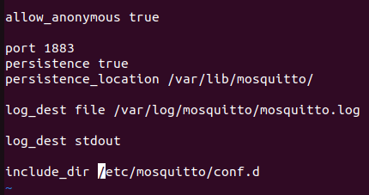
Case 1
/etc/mosquitto/mosquitto.conf
no authentication
Listen port 1883
Print log in console

Slide 27
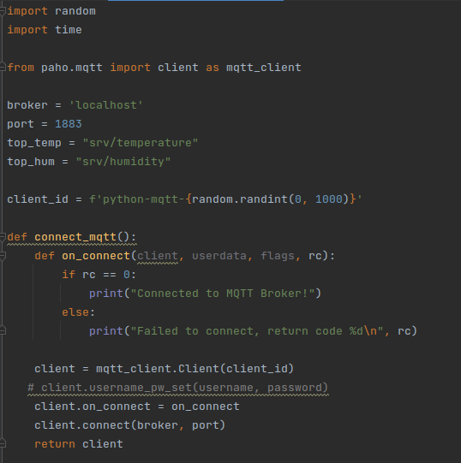
Case 1
params
Connect function
mqqt_publish.py
Client(client_id="", clean_session=True, userdata=None, protocol=MQTTv311, transport="tcp")

Slide 28
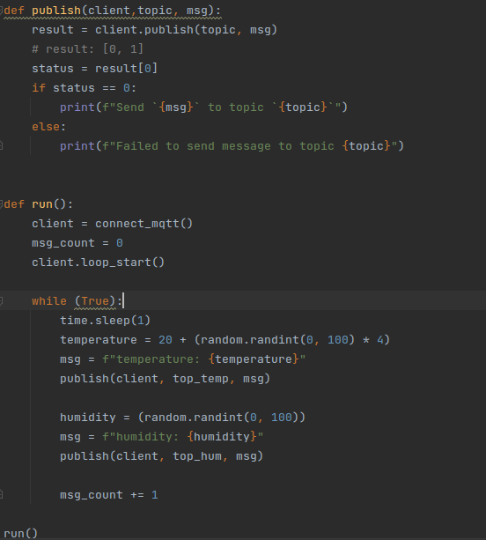
Case 1
LOOP_START() / LOOP_STOP(): These functions implement a threaded interface to the network loop. Calling loop_start() once, before or after connect*(), runs a thread in the background to call loop() automatically. This frees up the main thread for other work that may be blocked. This call also handles reconnecting to the broker. Call loop_stop() to stop the background thread. The force argument is currently ignored.
mqqt_publish.py

Slide 29
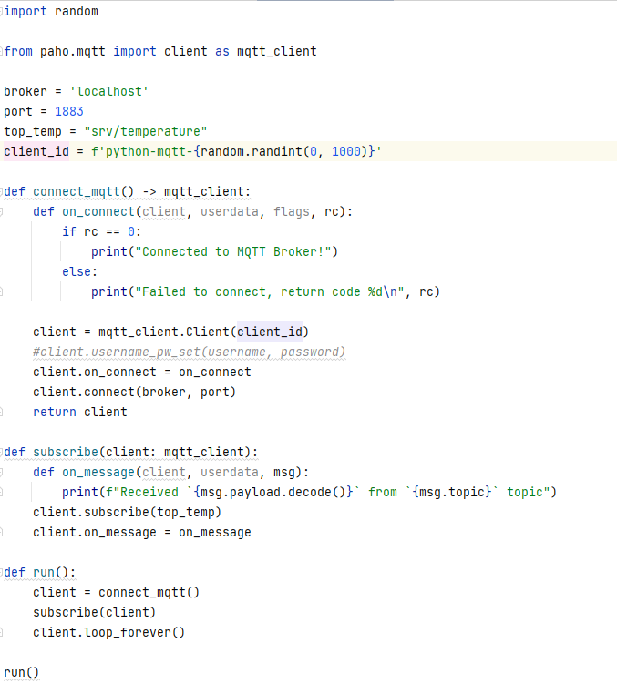
Case 1
Called when a message has been received on a topic that the client subscribes to, and the message does not match an existing topic filter callback. Use message_callback_add() to define a callback that will be called for specific topic filters. on_message will serve as fallback when none matched.
mqqt_sub_temp.py

Slide 30
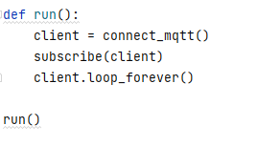
Case 1
This is a blocking form of the network loop and will not return until the client calls disconnect(). It automatically handles reconnecting.
mqqt_sub_temp.py

Slide 31
Case 1
This is a blocking form of the network loop and will not return until the client calls disconnect(). It automatically handles reconnecting.
mqqt_sub_humid.py

Slide 32
Case 2
Humidity: 10%
Topic: Humidity
Humidity: 10%
Subscriber 2
Topic: Humidity
bridge_central
Publisher
Bridge Broker
1883
Central Broker
1884
Temperature: 24ºC
Topic: Temperature
Temperature: 24ºC
Subscriber 2
Topic: Temperature

Slide 33
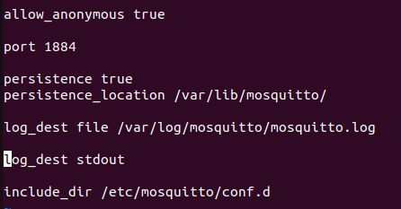
Case 2
Central Broker
1884

Slide 34
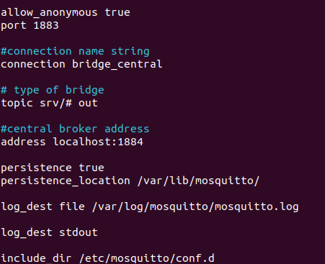
Case 2
Connection name: used to log
Bridge Broker
1883
Address of the central broker

Slide 35
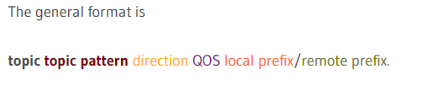
Case 2
out = publish from the broker
in = receive from the remote broker
both = publish and receive
Bridge Broker
1883

Slide 36
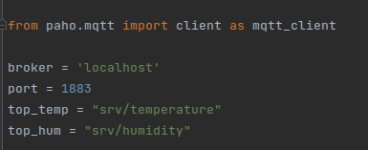
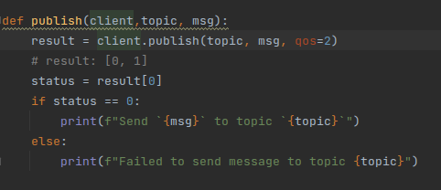
Case 2
Check that port is correct!
Change the QOS of publish
Publisher

Slide 37
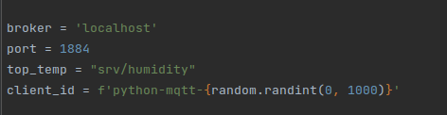
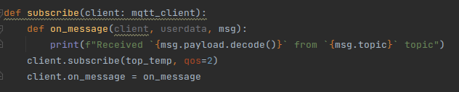
Case 2
Check that port is correct!
Subscriber 2
Topic: Humidity
Change the QOS of SUBSCRIPTION
Subscriber 2
Topic: Temperature

Slide 38
Challenge
Group Activity
Due Date: end of class
Humidity: 10%
Topic: Humidity
Humidity: 10%
Subscriber 2
Topic: Humidity
bridge1_central
Publisher1
BridgeBroker1
1883
Central Broker
1884
Temperature: 24ºC
bridge2_bridge3
bridge3_central
Subscriber 2
Topic: Temperature
Topic: Temperature
Temperature: 24ºC
BridgeBroker2
1885
Publisher2
BridgeBroker3
1886

Slide 39
Unit 6.5 (Extra) MQTT Advanced

